Slide 1

Space and Place to Think: the Contravision Approach

Slide 2
The Project
Exploring potential interactions between ‘smart grid’ technologies and practices in the home
The Challenge: How to engage participants with technologies yet to be built?
  How to get participants interested?
  How to inform them of the potential technologies?
  How to encourage them to think openly and critically?
  How to get them thinking about the consequences for their own lives?

Slide 3
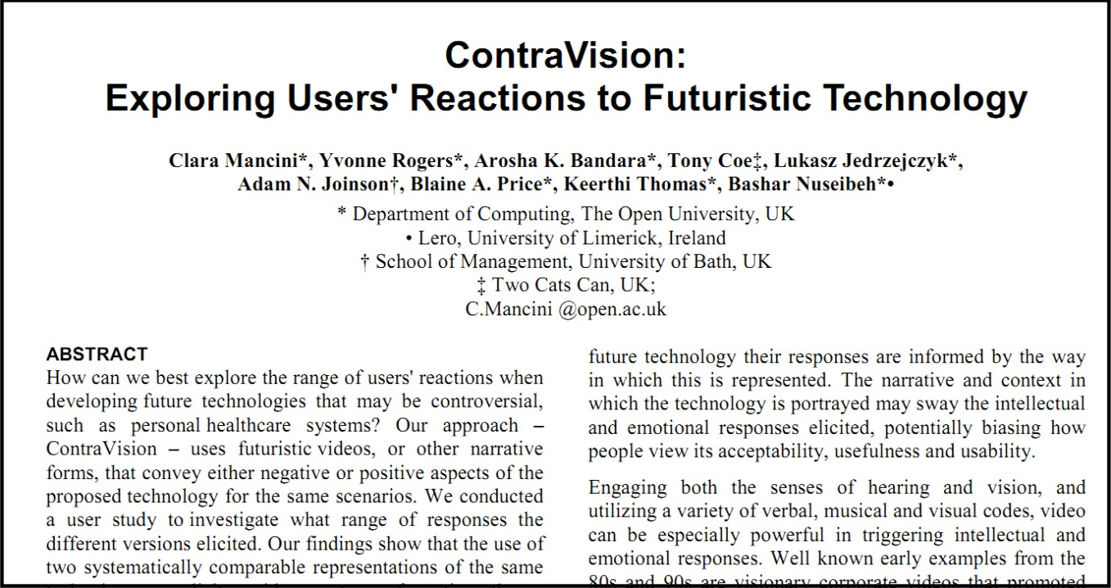
The Approach
“Similar to stereoscopic vision, the ContraVision method can offer two contrasting points of view for the same object, providing a perception of ‘depth’ that, just like monoscopic vision, a single representation cannot provide.” Mancini et al. 2010
Notes:
Variation on vignettes – but explict contrasting visions, and engaging medium

Slide 4
The Process
Four focus groups, 72 participants
Three short films, ‘dark’ and ‘light’ versions of each
  Expert workshop to identify possible technologies
  Technologies considered alongside set of themes to generate narratives
  Deliberate use of humour and characterisation, aided by extreme utopian and dystopian visions
  Storyboarding
  Still photography as the medium
  Assembled into montage with free software
  Narrative given through voice-over

Slide 5
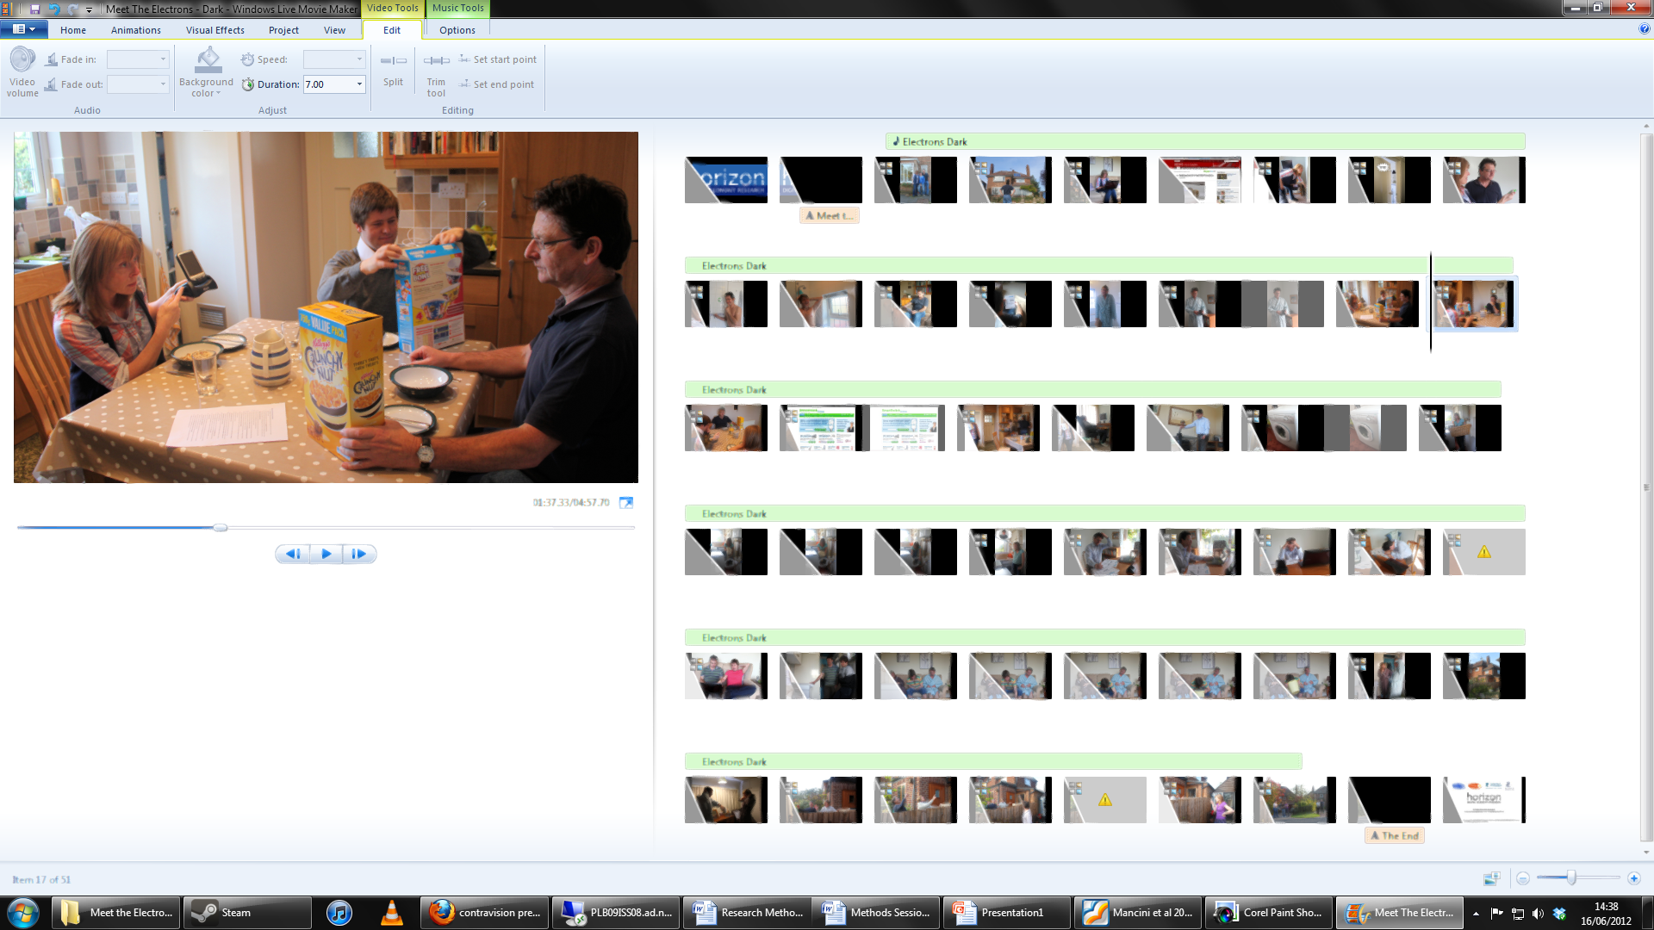

Slide 6
Feedback

Slide 7
Feedback

Slide 8
Open Feedback
“Excellent films and good discussions.”
“A very thought provoking afternoon. It made me recognise things that only existed at the back of my mind.”
“An informative and entertaining afternoon.”
“The films could perhaps have covered other energy supplies, in particular oil is the main source of heating in this village rather than electricity (there being no gas supply).”
“The films showed only a very small part of society so they can’t easily be generalised. But several issues were mentioned, which gave good content for discussion.”
“Good”.

Slide 9
Conclusions
Contravision approach provides a highly engaging frame
Medium used in project required no specialist skills or equipment (microphone excepted) to create
Particularly suited to investigating circumstances yet to materialise in real world settings
Embedding technological visions in social (meaningful) contexts
Place and space to think
Usual methodological shortcomings of focus groups and vignettes, but raises at least one specific question:
  How ‘open’ is the Contravision view? Is the dystopian account more engaging, and if so what are the consequences?

